Slide 1
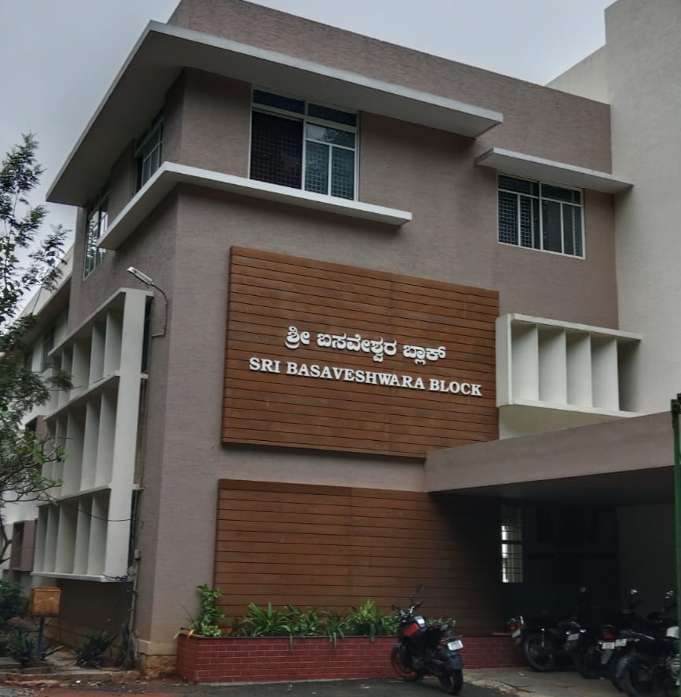
COMMUNITY PROJECT PHASE-I EVALUATION · 2026–27
College Hostel
Allocation System
A Secure, Priority-Aware Digital Platform for Transparent and Efficient Hostel Seat Allocation
Siddaganga Institute of Technology, Tumakuru
Department of Computer Science and Engineering
Siddharth Yadav · 1SI25CS233
Snehil Pandey · 1SI25CS237
Suprem Timsina · 1SI25CS250
Sourabh Raghoji · 1SI25CS239
Sudarshan Raj Bhattarai · 1SI25CS247
Saugat Rauniyar · 1SI25CS217
Faculty Guide: Mr. Ravi V
Community Partner: [Community Partner — to be confirmed]
A
B
C
Notes:
Introduce the project, team and guide. Replace all bracketed placeholders and the photo slot before presenting. Everything that follows is a proposed solution under evaluation, not a deployed system. Next: why this problem matters.

Slide 2
INTRODUCTION AND CONTEXT
From Manual Queues to a Shared Digital Record
Same goal — fair seat allocation — handled very differently.
TRADITIONAL (general practice)
PROPOSED DIGITAL PLATFORM
Conceptual UI Mockup
7
8
9
10
Physical queue
Priority queue
Manual
verification
Repeated
enquiries
Dashboard
& status
A
B
C
Paper records
Visual seat map
Records may be scattered; availability is hard to see.
One shared record, visible by role.
Transparency: students can see status and seat availability
Consistency: one shared record instead of scattered ones
Administration: less repeated manual follow-up (expected)
Manual-process difficulties are reported in hostel-system literature [1], [3], [4]; prevalence at the target hostel is to be validated.
SIT Tumakuru · Dept. of CSE · Community Project Phase-I, 2026–27
2
Notes:
Explain the comparison simply. Qualify: these are general patterns reported in the literature, not measured claims about our partner hostel. The UI on the right is a concept. Next: who the community is and how needs will be assessed.

Slide 3
COMMUNITY PROFILE AND NEEDS ASSESSMENT
PLANNED NEEDS ASSESSMENT — NO FIELDWORK REPORTED YET
Who Is Affected, and How We Will Find Out
Hostel students
Hostel-office staff
PLANNED ACTIVITIES
1
Structured student questionnaire
2
Interviews with warden and hostel office
HOSTEL
PLATFORM
3
Observation of the current allotment process
4
Review of existing rules and records
5
Permission and consent from the partner
Wardens
Administrators
Intended beneficiaries: students seeking seats; staff who verify, allocate and respond to complaints.
Community partner: [Community Partner — to be confirmed]
SIT Tumakuru · Dept. of CSE · Community Project Phase-I, 2026–27
3
Notes:
Be explicit that this is planned work. If any survey, interview or visit has already happened, replace the planned list with the real findings and evidence. Never present assumptions as findings. Next: what existing work tells us.

Slide 4
LITERATURE REVIEW (1 OF 2)
Existing Hostel-Management Systems
Reviewed from published abstracts and records; references on slide 15.
SOURCE
APPROACH STUDIED
MAIN CONTRIBUTION
RELEVANCE TO THIS PROJECT
[3] Waibi, 2022
Web-based hostel system, Makerere Univ. (PHP/MySQL)
Students apply online; central database allocates rooms and keeps records.
Closest model for registration + allocation records.
[4] Aneke, 2018
Web-based hostel allocation, Godfrey Okoye Univ.
Central database allocates rooms automatically; keeps occupancy records and reports.
Supports occupancy reporting; allocation unit is a room.
[2] Kon, 2025
RoomPro, UNIMAS: web hostel system with GA room allocation
Optimised room assignment run in background; survey-based requirements; usability testing.
Shows requirement surveys and usability evaluation.
[1] Tharu et al., 2025
Role-based hostel system, Chitkara Univ.
Three-tier web system for students and wardens: gate passes, maintenance requests, history logs.
Role-based access and request tracking.
[5] Okokpujie et al., 2018
Smart hostel management using RFID and biometrics
Title-level review: identity-linked hostel management.
Context on identity verification; scope to be checked.
Several sources are student project reports or dissertations; they show common approaches but vary in peer-review level.
SIT Tumakuru · Dept. of CSE · Community Project Phase-I, 2026–27
4
Notes:
Walk through the five sources briefly. Be candid that some are dissertations/project reports. Source [5] was reviewed at title level only. Next: compare capabilities across these systems and adjacent research.

Slide 5
LITERATURE REVIEW (2 OF 2)
What Existing Work Documents — and Where Opportunities Remain
Digital records
Automated allocation
Priority-aware
Seat-level
Live occupancy
Audit trail
Role-based access
Complaints / requests
[1] Tharu
documented
not documented
not documented
not documented
not documented
documented
documented
documented
[2] Kon
not documented
documented
not documented
not documented
not documented
not documented
not documented
not documented
[3] Waibi
documented
documented
not documented
not documented
not documented
not documented
not documented
not documented
[4] Aneke
not documented
documented
not documented
not documented
documented
not documented
not documented
not documented
Proposed
proposed
proposed
proposed
proposed
proposed
proposed
proposed
proposed
"Not documented" = not stated in the reviewed abstract; it is not evidence that the capability is absent. "Proposed" = design intent, not implemented.
ADJACENT RESEARCH THAT INFORMS THE DESIGN
Fair assignment [7], [8]
Access control [9], [11]
Transaction integrity [10], [12]
Privacy [13]
Fuzzy allocation [6]
Reviewed sources: [1]–[4] by abstract. Priority-aware, seat-level and live-occupancy allocation are not documented in them — an opportunity to validate, not a proven gap.
SIT Tumakuru · Dept. of CSE · Community Project Phase-I, 2026–27
5
Notes:
Read the matrix carefully: green means documented in the abstract, grey means not documented in what we reviewed. The Proposed row is our design intent. The bottom chips show adjacent research on fairness, access control, concurrency and privacy that supports design choices. Next: the limitations we want to test.

Slide 6
LIMITATIONS OF EXISTING APPROACHES
CANDIDATE PROBLEMS — TO BE VALIDATED WITH THE COMMUNITY
Candidate Gaps to Validate
POSSIBLE CAUSES
POSSIBLE EFFECTS
Paper records and manual steps
Delays and repeated enquiries
No live view of seat availability
Slow, unclear and hard-to-audit hostel allocation
Confusion about status and availability
Priority rules applied by hand
Inconsistent record updates
Complaints and changes tracked loosely
Limited traceability of decisions
Manual-process issues are described in [1], [3], [4]; whether they apply to the partner hostel is to be confirmed by the needs assessment.
SIT Tumakuru · Dept. of CSE · Community Project Phase-I, 2026–27
6
Notes:
Emphasise that these are hypotheses drawn from literature. Our needs assessment will confirm, refine or discard them. Next: the problem statement.

Slide 7
PROBLEM STATEMENT
Clear Problem Statement
Hostel students, wardens and hostel-office staff often rely on manual or fragmented processes to register applicants, apply priority rules and allot seats. This can lead to delays, limited visibility of availability and allocation status, inconsistent records and difficult follow-up. There is a need for a secure, transparent and manageable digital system that applies priority consistently, records every allocation and controls who can see what.
Visibility
Priority
Records
Accountability
Seat availability and status are hard to see
Rules are hard to apply consistently
Updates can become inconsistent
Decisions are hard to trace
Problem framing is based on the literature [1], [3], [4] and is subject to validation with the community.
SIT Tumakuru · Dept. of CSE · Community Project Phase-I, 2026–27
7
Notes:
Read the statement once, then point to the four challenges. No statistics are claimed. Next: objectives.

Slide 8
PROJECT OBJECTIVES
One General Objective, Five Verifiable Specific Objectives
GENERAL OBJECTIVE
Design and develop a secure, priority-aware web platform that makes hostel seat allocation transparent, consistent and manageable.
SO1
SO2
SO3
Digitize registration and eligibility
Model occupancy per seat
Priority-aware allocation workflow
Verify: Staff can register an applicant and record year, quota and priority
Verify: A room with 3 beds can show 2 occupied, 1 available
Verify: Turns follow priority order; only the active student can confirm
SO4
SO5
Prevent conflicting confirmations
Role-based access, complaints, room change
Verify: Two attempts on one seat yield exactly one success (test)
Verify: Users see only permitted data; requests are tracked to closure
SIT Tumakuru · Dept. of CSE · Community Project Phase-I, 2026–27
8
Notes:
Each specific objective has a way to verify it during implementation and testing. These are goals, not results. Next: how the solution works.

Slide 9
PROPOSED SOLUTION AND METHODOLOGY
How a Seat Gets Allocated
1
2
3
4
5
Registration
Staff verification
Eligibility + priority
Waiting queue
Student's turn
6
7
8
9
10
Live hostel map
Seat selection
Confirmation (atomic)
Allocation record
Publication + notifications
Staff action
Student action
Backend-enforced
The backend — not the browser — decides eligibility, priority, timing and availability.
SIT Tumakuru · Dept. of CSE · Community Project Phase-I, 2026–27
9
Notes:
Trace the numbered steps. Navy = staff, blue = student, teal = enforced by the server. Row two continues from step 5 to step 6. Qualify: this is the intended workflow; timings and rules are configurable and not yet approved by the college. Next: what the screens could look like.

Slide 10
SYSTEM FEATURES AND VISUAL WALKTHROUGH
What Users Would See
All screens are conceptual and not from a working application.
STUDENT DASHBOARD
WAITING ROOM · QUEUE
HOSTEL MAP · FLOOR 3
Conceptual UI Mockup
Conceptual UI Mockup
Conceptual UI Mockup
Priority
assigned by staff
7
8
9
10
11
301
302
303
Eligibility
Verified
Active turn — countdown shown by UI, enforced by server
A
B
C
A
B
C
A
B
Allocation
Not yet allocated
free · taken · mine · not eligible
SEAT CONFIRMATION
ADMIN · OCCUPANCY
SEAT-LEVEL ALLOCATION
Conceptual UI Mockup
Conceptual UI Mockup
Room 301 · Seat B · Floor 3
Building A
A
B
C
Building B
Confirm seat
Cancel
Building C
Building D
Capacity 3 · Occupied 2 · Available 1
Server re-checks turn, eligibility and availability.
Occupied vs available (illustrative, not real data)
A room need not be empty to allocate a seat.
SIT Tumakuru · Dept. of CSE · Community Project Phase-I, 2026–27
10
Notes:
Walk the journey: dashboard, queue, map, confirm, admin view, and the seat-level idea. Every screen is a concept drawn for this deck, not a screenshot. The numbers in the occupancy view are illustrative only. Next: who benefits.

Slide 11
SOCIAL RELEVANCE AND APPLICATIONS
EXPECTED OUTCOMES — NOT MEASURED ACHIEVEMENTS
Who Benefits, and How
Students
See seat availability and own status; fewer repeated enquiries
SUSTAINABILITY
Maintainable software
Hostel-office staff
Structured allocation; one shared record
Reusable floor-plan data
Wardens
Track complaints and room changes within their scope
Configurable rules
Administrators
Oversight through occupancy views and audit history
Possible extension to other student accommodation (to be assessed)
SIT Tumakuru · Dept. of CSE · Community Project Phase-I, 2026–27
11
Notes:
Link each stakeholder to a benefit we expect, not one we have measured. Sustainability comes from configurable rules and reusable data. Next: what we need to build it.

Slide 12
PROJECT REQUIREMENTS
What the Project Needs
Technology choices are proposed, not finalized.
SOFTWARE
HARDWARE & INFRASTRUCTURE
· Web application: frontend + backend
· Developer laptops
· Relational database (e.g., PostgreSQL — proposed)
· Reliable network access
· Authentication and role-based authorization
· Test server or hosting resources
· Hosting / deployment environment
· Partner computers, if applicable
HUMAN RESOURCES
DATA & PERMISSIONS
· Student development team
· Approved floor plans and seat capacities
· Faculty guide
· Operational rules from the hostel
· Hostel staff / community representatives
· Permission for surveys / interviews
· Volunteer users for feedback and testing
· Consent and privacy safeguards
Privacy safeguards to follow the Digital Personal Data Protection Act, 2023 [13]; legal applicability to be confirmed with the institution.
SIT Tumakuru · Dept. of CSE · Community Project Phase-I, 2026–27
12
Notes:
Four groups of needs. Stress that PostgreSQL and the web stack are proposals. Data and permissions are as important as software: floor plans, rules and consent must come from the hostel. Next: the plan.

Slide 13
PROJECT EXECUTION PLAN
PROPOSED RELATIVE SCHEDULE — ALL TASKS PLANNED
Proposed Schedule and Review Points
W1
W2
W3
W4
W5
W6
W7
W8
W9
W10
1 Community interaction + requirements
2 Existing-system study + finalize requirements
3 UI/UX design + floor-plan modeling
4 Backend + database development
5 Frontend development + integration
6 Functional, security, usability testing
7 Community feedback + refinement
8 Documentation + final presentation
Reviews with faculty guide and community representatives
R1
R2
R3
Requirements review
Design review
Prototype review
SIT Tumakuru · Dept. of CSE · Community Project Phase-I, 2026–27
13
Notes:
This is a relative schedule; replace weeks with actual dates from the academic calendar. Nothing here is marked complete. R1–R3 are planned reviews with the guide and community representatives. Next: conclusion.

Slide 14
CONCLUSION AND EXPECTED OUTCOMES
Making Hostel Allocation Transparent, Accountable and Manageable
PROBLEM
Manual, fragmented hostel allocation (to be validated)
ROOM 301
A
B
C
PROPOSAL
Priority-aware, seat-level, role-controlled platform
EXPECTED BENEFIT
Visibility, consistent records, easier oversight
The system allocates a seat, not a room.
NEXT PHASE
Conceptual illustration
Needs assessment, design, prototype, testing
The goal is not merely to digitize seat allocation, but to make the process more transparent, accountable and manageable.
Thank you · Questions
SIT Tumakuru · Dept. of CSE · Community Project Phase-I, 2026–27
14
Notes:
Recap the problem, proposal and expected benefits. These are expected outcomes, not proven results. Close with the next phase and invite questions.

Slide 15
REFERENCES
References (IEEE)
[1] A. Tharu, K. K. Sah, and H. Kaur, "Design and implementation of an integrated hostel management system with role-based access for students and wardens," J. Technol. Manag., pp. 105–117, Dec. 2025. doi: 10.15415/jtmge/2025.161009
[8] D. Gale and L. S. Shapley, "College admissions and the stability of marriage," Amer. Math. Monthly, vol. 69, no. 1, pp. 9–15, 1962. doi: 10.2307/2312726
[2] J. Kon Xin Yue, "RoomPro: A web-based hostel room allocation using genetic algorithm and management system," B.Sc. (Hons) project, Univ. Malaysia Sarawak, 2025. https://scholarhub.unimas.my/handle/123456789/379
[9] R. S. Sandhu, E. J. Coyne, H. L. Feinstein, and C. E. Youman, "Role-based access control models," Computer, vol. 29, no. 2, pp. 38–47, 1996. doi: 10.1109/2.485845
[3] Z. Waibi, "Web-based hostel management system," undergraduate dissertation, Makerere Univ., Apr. 2022. https://dissertations.mak.ac.ug/handle/20.500.12281/11875
[10] H. Berenson et al., "A critique of ANSI SQL isolation levels," in Proc. ACM SIGMOD, 1995. doi: 10.1145/223784.223785
[4] S. C. Aneke, "Development of a web based hostel allocation system," Godfrey Okoye Univ., Enugu, 2018. https://eprints.gouni.edu.ng/418/
[11] OWASP, "OWASP API Security Top 10 — 2023: API1 Broken Object Level Authorization." https://owasp.org/API-Security/
[5] K. O. Okokpujie et al., "A smart hostel management system using RFID and biometric technology," Procedia Comput. Sci., vol. 143, pp. 489–496, 2018. doi: 10.1016/j.procs.2018.10.423
[12] PostgreSQL Global Development Group, "PostgreSQL documentation: Partial indexes." https://www.postgresql.org/docs/current/indexes-partial.html
[6] A. Sharma and A. Kaur, "Hostel's room allocation system: A framework using single-layer fuzzy logic," in Proc. ICICC, 2021. https://papers.ssrn.com/sol3/papers.cfm?abstract_id=3833297
[13] Government of India, "The Digital Personal Data Protection Act, 2023 (No. 22 of 2023)," MeitY. https://www.meity.gov.in/data-protection-framework
[7] A. Abdulkadiroğlu and T. Sönmez, "School choice: A mechanism design approach," Amer. Econ. Rev., vol. 93, no. 3, pp. 729–747, 2003. doi: 10.1257/000282803322157061
[1]–[6]: hostel-specific literature. [7]–[13]: adjacent research and official documentation (fair allocation, access control, concurrency, privacy).
SIT Tumakuru · Dept. of CSE · Community Project Phase-I, 2026–27
15
Notes:
References are in IEEE style. [1]–[6] are hostel-specific; [7]–[13] are adjacent research and official documentation. Verify any link before submission.

